Slide 1

SOFTWARE ENGINEERING
Software Architecture by Prof. Mohamad Kassab
Leonidas Kontothanassis kthanasi@bu.edu

Slide 2
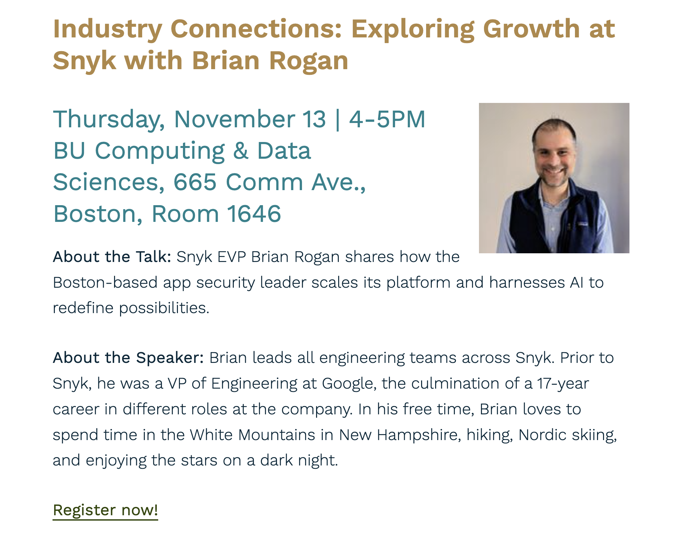

Slide 3
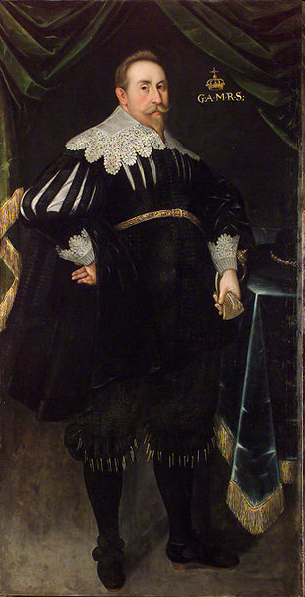
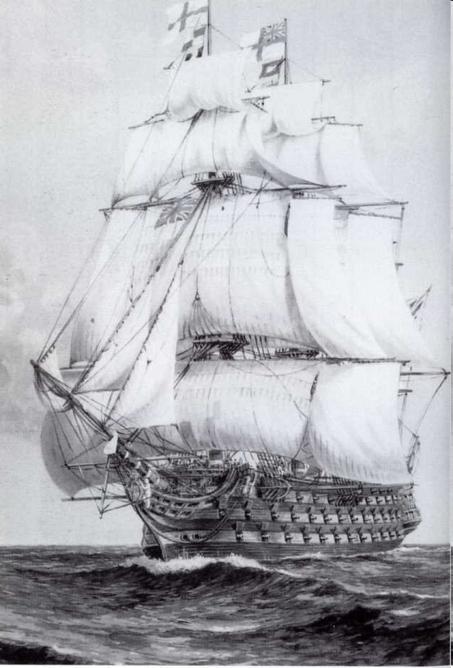


Story of ‘Vasa’ battleship (~1620)
Gustavus Adolphus,
King of Sweden 1611-32
Henrik Hybertsson
Ship designer
Multi-deck battleship
Inquiries concluded that the ship was “badly proportioned”
Vasa is sinking after sailing1300 meters
Notes:
King kept changing the design to make it more “impressive”
He added two rows of cannons.
They had to increase the height to accommodate that and did not scale other dimensions.
Apparently just the sailors running on the deck would make it sway dangerously!!!
Political pressure required the ship to sail. Once a light wind hit it outside the harbor it capsized
It is now in the naval museum in Stockholm.

Slide 4
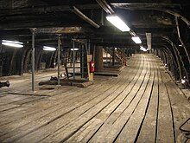



Slide 5
A story of the Swedish ship Vasa
For decades, software designers have been taught to build systems exclusively on the technical requirements
Requirements beget design, which begets system
This is a short-sighted view
What do you suppose would happen if two different architects, working in two different organizations, were given the same requirements specification for a system? Do you think they will produce the same architecture or different one?

Slide 6

What is Software Architecture?
The software architecture of a system is the set of structures needed to reason about the system, which comprise software elements, relations among them, and properties of both.

Slide 7
Architecture Is a Set of Software Structures
A structure is a set of elements held together by a relation.
Software systems are composed of many structures, and no single structure holds claim to being the architecture.
There are three important categories of architectural structures.
Module
Component and Connector
Allocation
Notes:
Module = Code view (the modules of the system) Components and Connectors = Runtime elements that do computation and store data Allocation = How components map onto hardware

Slide 8

Physiological Structures

Slide 9
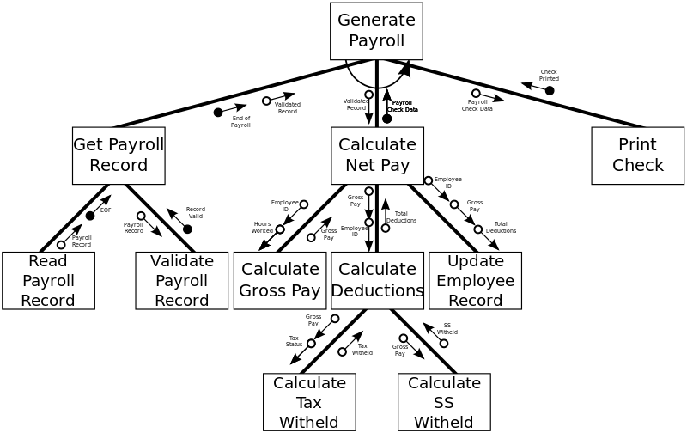
Module Structures
Notes:
Elements, Relations and Properties. Data and Metadata (hollow vs solid circles).

Slide 10
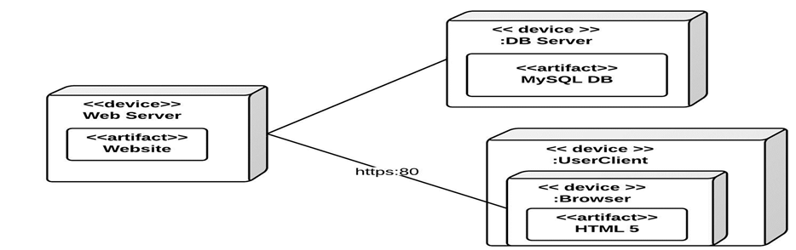
Allocation Structure
Notes:
How code is allocated to physical machines, or separate process/VM on a single machine.

Slide 11
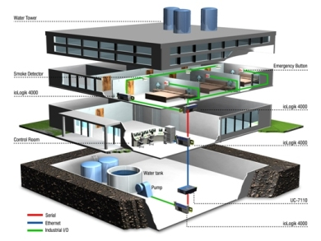
Building Automation System (BAS) – Case Study

Slide 12
Building Automation System
Consider a company that primarily sells hardware devices for building automation.
They have software applications that manage a network of these devices but this constitutes a loss leader, i.e. they lose money on the software but it helps the sale of the hardware devices.
The company realizes that the hardware is being commoditized and over time the profit margins on the sale of their hardware devices are going to shrink. In order to sustain their business long term, the company decides to create a new building automation system that will be profitable.

Slide 13
Building Automation System
They wish to accomplish this by doing two things
– reduce internal development costs and expand the market.
Internal development costs can be reduced by replacing several of the existing applications with a single building automation system.
Market expansion can be achieved by entering new and emerging geographic markets and opening new sales channel in the form of Value Added Resellers (VARs). VARs sell the new building automation system under their own brand to support building automation hardware devices of many different manufacturers.

Slide 14
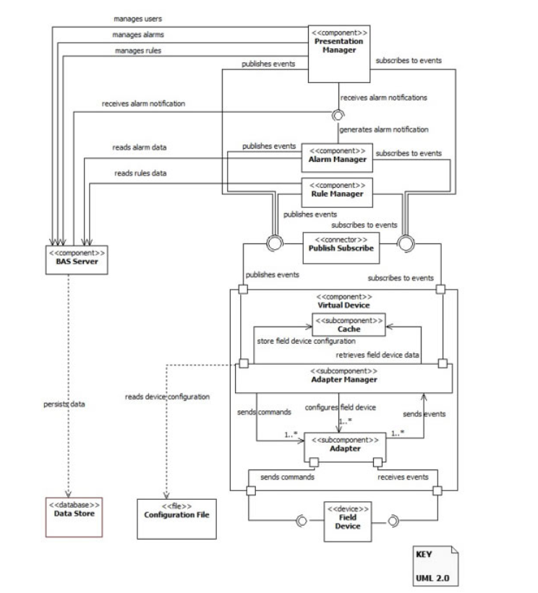
Notes:
Example of component connector diagram. Lollipop (concentric circles) is producer/consumer notation. Circle is consumer, partial circle is producer. The little square is notation for a message passing interface. Example of something left in BAS: Security policies, auth etc.

Slide 15
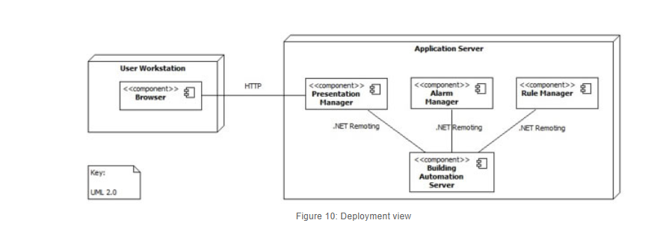
Notes:
Previous slide, divided on machines.

Slide 16
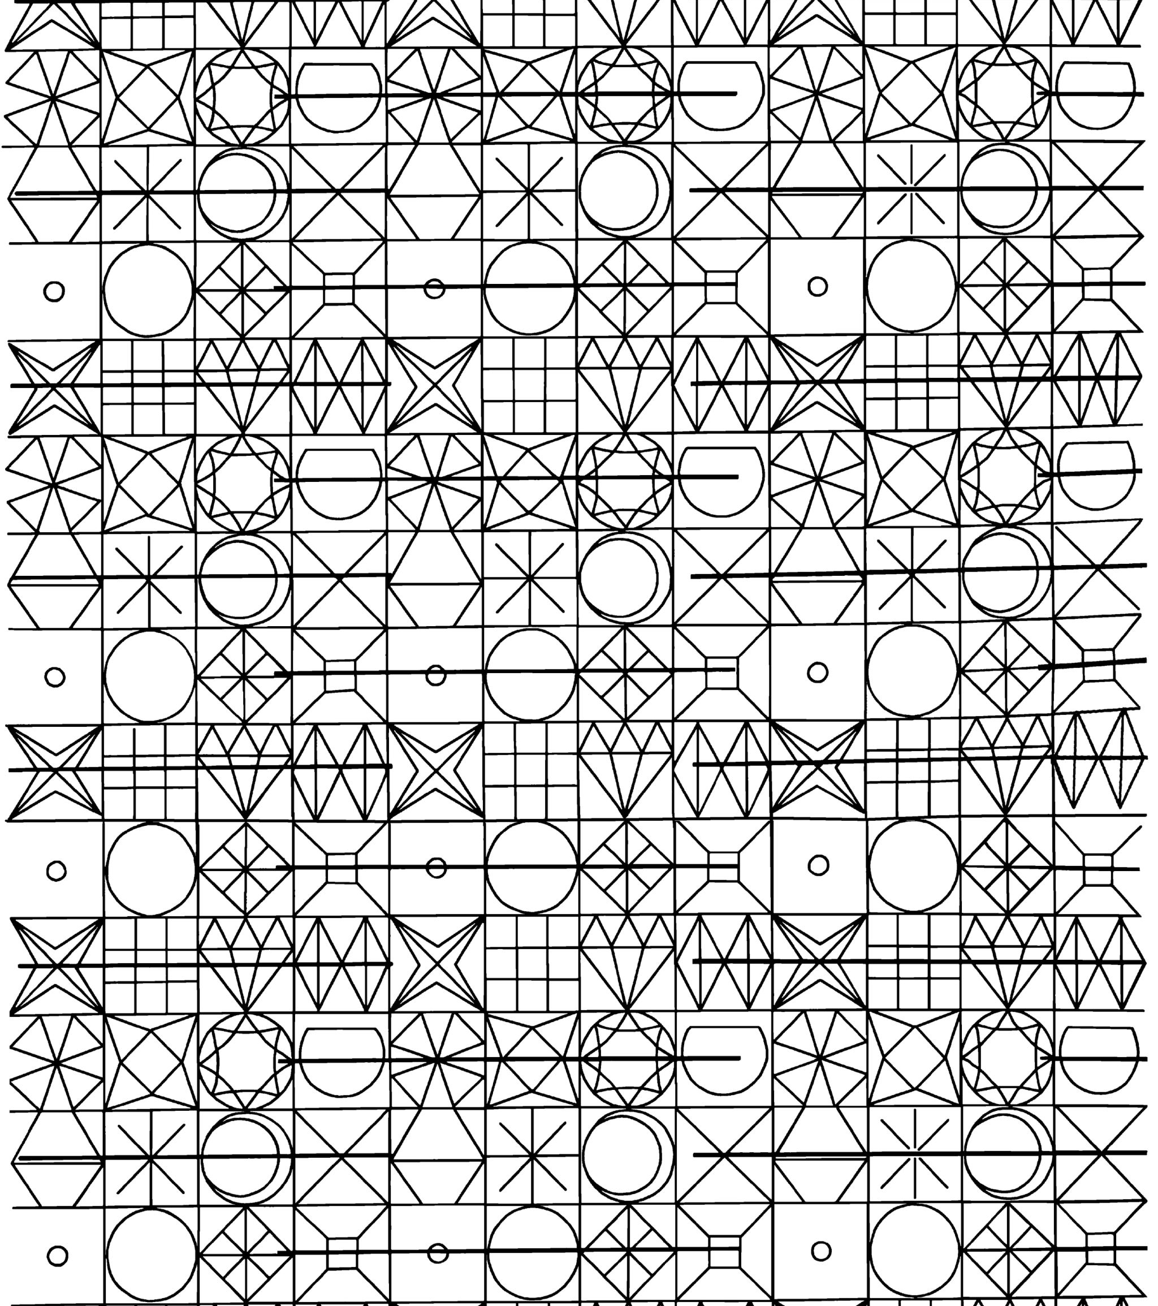
Architectural Patterns
What is a Pattern?
Pattern Catalogue
Module patterns
Component and Connector Patterns
Allocation Patterns
Relation Between Tactics and Patterns
Using tactics together
Summary

Slide 17
Architectural Patterns
Layer Pattern
Broker Pattern
Model View Controller Pattern
Pipe and Filter Pattern
Client Server Pattern
Peer to Peer Pattern
Publish Subscribe Pattern

Slide 18
Building Automation System
The building automation system has a modifiability quality attribute requirement – a need to integrate hardware devices from many different manufacturers.
More concretely, the requirement cast as a quality attribute scenario states “a field engineer should be able to integrate a new hardware device into the system at runtime and the system should continue to operate with no downtime or side effects.”
How do we achieve this requirement?

Slide 19
Let’s look at similar systems
operating systems experience a high degree of variability in dealing with the underlying hardware devices on the machine they must run on.
How do you think this variability is handled?

Slide 20
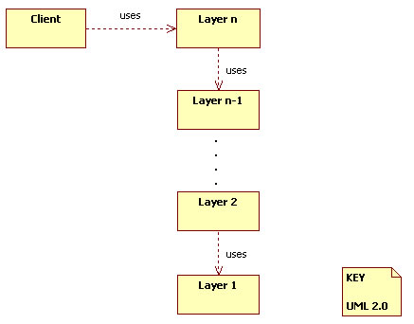
Operating Systems Example

Slide 21
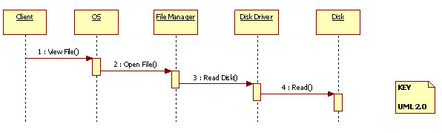
Operating Systems Example

Slide 22
Operating Systems Example
In this scenario, the disk driver directly interfaces with a physical disk thereby abstracting away from the file manager the details of the protocol to follow when communicating with the physical disk.
The file manager uses appropriate disk driver to communicate with a physical disk thereby abstracting away from the operating system the details of how requests are routed to and responses received from (possibly) multitude of disk drives.
In so far as the operating system is concerned, there is a single (virtual) disk. The operating system abstracts away from the client how the underlying hardware disks are being managed.

Slide 23
Architectural Patterns
This example demonstrates that there can be a recurring problem that arises in a given context that can be resolved using a well-proven solution to the problem.
In the example presented, the problem in the operating systems domain also reoccurs in the building automation domain and is, therefore, resolved using a well-proven hierarchical layering structure or Layers Pattern.
A pattern describes a particular recurring design problem that arises in specific design contexts, and presents a well-proven solution for the problem. The structures designed by architects of software systems are often based on one or more patterns.

Slide 24
What is a Pattern?
An architectural pattern establishes a relationship between:
A context. A recurring, common situation in the world that gives rise to a problem.
A problem. The problem, appropriately generalized, that arises in the given context.
A solution. A successful architectural resolution to the problem, appropriately abstracted. The solution for a pattern is determined and described by:
A set of element types (for example, data repositories, processes, and objects)
A set of interaction mechanisms or connectors (for example, method calls, events, or message bus)
A topological layout of the components
A set of semantic constraints covering topology, element behavior, and interaction mechanisms

Slide 25
Layer Pattern
Context: All complex systems experience the need to develop and evolve portions of the system independently. For this reason the developers of the system need a clear and well-documented separation of concerns, so that modules of the system may be independently developed and maintained.
Problem: The software needs to be segmented in such a way that the modules can be developed and evolved separately with little interaction among the parts, supporting portability, modifiability, and reuse.
Solution: To achieve this separation of concerns, the layered pattern divides the software into units called layers. Each layer is a grouping of modules that offers a cohesive set of services. The usage must be unidirectional. Layers completely partition a set of software, and each partition is exposed through a public interface.

Slide 26
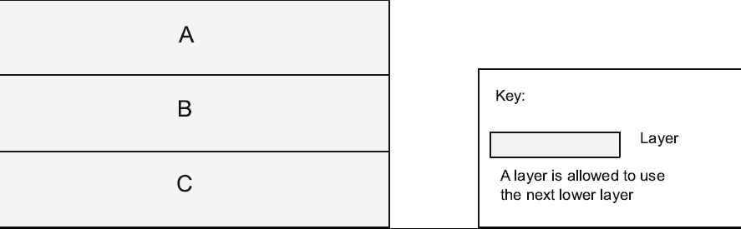
Layer Pattern Example

Slide 27
Layer Pattern Solution
Overview: The layered pattern defines layers (groupings of modules that offer a cohesive set of services) and a unidirectional allowed-to-use relation among the layers.
Elements: Layer, a kind of module. The description of a layer should define what modules the layer contains.
Relations: Allowed to use. The design should define what the layer usage rules are and any allowable exceptions.
Constraints:
Every piece of software is allocated to exactly one layer.
There are at least two layers (but usually there are three or more).
The allowed-to-use relations should not be circular (i.e., a lower layer cannot use a layer above).
Weaknesses:
The addition of layers adds up-front cost and complexity to a system.
Layers contribute a performance penalty.

Slide 28
Broker Pattern
Context: Many systems are constructed from a collection of services distributed across multiple servers. Implementing these systems is complex because you need to worry about how the systems will interoperate—how they will connect to each other and how they will exchange information—as well as the availability of the component services.
Problem: How do we structure distributed software so that service users do not need to know the nature and location of service providers, making it easy to dynamically change the bindings between users and providers?
Solution: The broker pattern separates users of services (clients) from providers of services (servers) by inserting an intermediary, called a broker. When a client needs a service, it queries a broker via a service interface. The broker then forwards the client’s service request to a server, which processes the request.

Slide 29
Broker Example

Slide 30
Broker Solution
Overview: The broker pattern defines a runtime component, called a broker, that mediates the communication between a number of clients and servers.
Elements:
Client, a requester of services
Server, a provider of services
Broker, an intermediary that locates an appropriate server to fulfill a client’s request, forwards the request to the server, and returns the results to the client
Client-side proxy, an intermediary that manages the actual communication with the broker, including marshaling, sending, and unmarshaling of messages
Server-side proxy, an intermediary that manages the actual communication with the broker, including marshaling, sending, and unmarshaling of messages

Slide 31
Broker Solution - contd
Relations: The attachment relation associates clients (and, optionally, client-side proxies) and servers (and, optionally, server-side proxies) with brokers.
Constraints: The client can only attach to a broker (potentially via a client-side proxy). The server can only attach to a broker (potentially via a server-side proxy).
Weaknesses:
Brokers add a layer of indirection, and hence latency, between clients and servers, and that layer may be a communication bottleneck.
The broker can be a single point of failure.
A broker adds up-front complexity.
A broker may be a target for security attacks.
A broker may be difficult to test.

Slide 32
Model-View-Controller Pattern
Context: User interface software is typically the most frequently modified portion of an interactive application. Users often wish to look at data from different perspectives, such as a bar graph or a pie chart. These representations should both reflect the current state of the data.
Problem: How can user interface functionality be kept separate from application functionality and yet still be responsive to user input, or to changes in the underlying application’s data? And how can multiple views of the user interface be created, maintained, and coordinated when the underlying application data changes?
Solution: The model-view-controller (MVC) pattern separates application functionality into three kinds of components:
A model, which contains the application’s data
A view, which displays some portion of the underlying data and interacts with the user
A controller, which mediates between the model and the view and manages the notifications of state changes

Slide 33
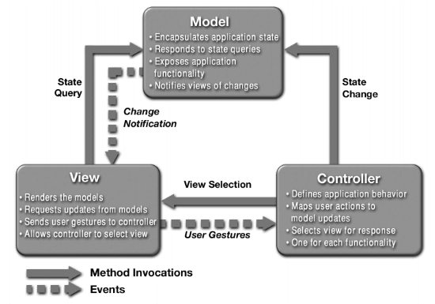
MVC Example

Slide 34
MVC Solution
Overview: The MVC pattern breaks system functionality into three components: a model, a view, and a controller that mediates between the model and the view.
Elements:
The model is a representation of the application data or state, and it contains (or provides an interface to) application logic.
The view is a user interface component that either produces a representation of the model for the user or allows for some form of user input, or both.
The controller manages the interaction between the model and the view, translating user actions into changes to the model or changes to the view.

Slide 35
MVC Solution - contd
Relations: The notifies relation connects instances of model, view, and controller, notifying elements of relevant state changes.
Constraints:
There must be at least one instance each of model, view, and controller.
The model component should not interact directly with the controller.
Weaknesses:
The complexity may not be worth it for simple user interfaces.
The model, view, and controller abstractions may not be good fits for some user interface toolkits.

Slide 36
Pipe and Filter Pattern
Context: Many systems are required to transform streams of discrete data items, from input to output. Many types of transformations occur repeatedly in practice, and so it is desirable to create these as independent, reusable parts.
Problem: Such systems need to be divided into reusable, loosely coupled components with simple, generic interaction mechanisms. In this way they can be flexibly combined with each other. The components, being generic and loosely coupled, are easily reused. The components, being independent, can execute in parallel.
Solution: The pattern of interaction in the pipe-and-filter pattern is characterized by successive transformations of streams of data. Data arrives at a filter’s input port(s), is transformed, and then is passed via its output port(s) through a pipe to the next filter. A single filter can consume data from, or produce data to, one or more ports.

Slide 37
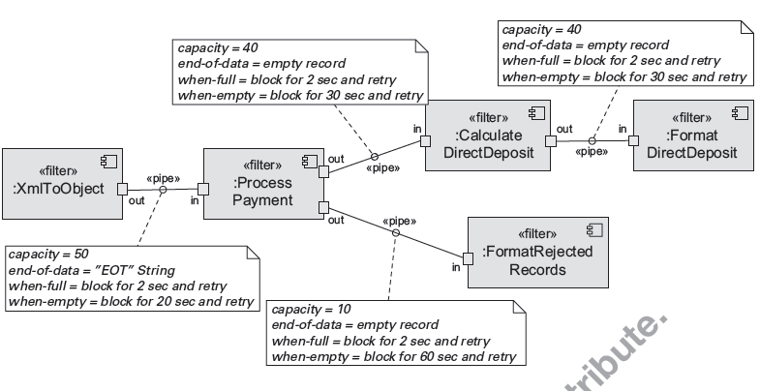
Pipe and Filter Example

Slide 38
Pipe and Filter Solution
Overview: Data is transformed from a system’s external inputs to its external outputs through a series of transformations performed by its filters connected by pipes.
Elements:
Filter, which is a component that transforms data read on its input port(s) to data written on its output port(s).
Pipe, which is a connector that conveys data from a filter’s output port(s) to another filter’s input port(s). A pipe has a single source for its input and a single target for its output. A pipe preserves the sequence of data items, and it does not alter the data passing through.
Relations: The attachment relation associates the output of filters with the input of pipes and vice versa.
Constraints:
Pipes connect filter output ports to filter input ports.
Connected filters must agree on the type of data being passed along the connecting pipe.

Slide 39
Client-Server Pattern
Context: There are shared resources and services that large numbers of distributed clients wish to access, and for which we wish to control access or quality of service.
Problem: By managing a set of shared resources and services, we can promote modifiability and reuse, by factoring out common services and having to modify these in a single location, or a small number of locations. We want to improve scalability and availability by centralizing the control of these resources and services, while distributing the resources themselves across multiple physical servers.
Solution: Clients interact by requesting services of servers, which provide a set of services. Some components may act as both clients and servers. There may be one central server or multiple distributed ones.

Slide 40
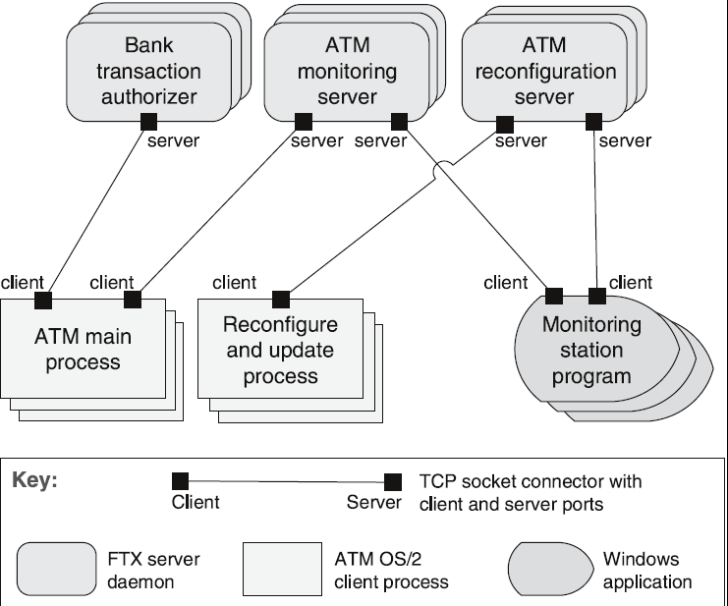
Client-Server Example

Slide 41
Client-Server Solution - 1
Overview: Clients initiate interactions with servers, invoking services as needed from those servers and waiting for the results of those requests.
Elements:
Client, a component that invokes services of a server component. Clients have ports that describe the services they require.
Server: a component that provides services to clients. Servers have ports that describe the services they provide.
Request/reply connector: a data connector employing a request/reply protocol, used by a client to invoke services on a server. Important characteristics include whether the calls are local or remote, and whether data is encrypted.

Slide 42
Client-Server Solution- 2
Relations: The attachment relation associates clients with servers.
Constraints:
Clients are connected to servers through request/reply connectors.
Server components can be clients to other servers.
Weaknesses:
Server can be a performance bottleneck.
Server can be a single point of failure.
Decisions about where to locate functionality (in the client or in the server) are often complex and costly to change after a system has been built.

Slide 43
Peer-to-Peer Pattern
Context: Distributed computational entities—each of which is considered equally important in terms of initiating an interaction and each of which provides its own resources—need to cooperate and collaborate to provide a service to a distributed community of users.
Problem: How can a set of “equal” distributed computational entities be connected to each other via a common protocol so that they can organize and share their services with high availability and scalability?
Solution: In the peer-to-peer (P2P) pattern, components directly interact as peers. All peers are “equal” and no peer or group of peers can be critical for the health of the system. Peer-to-peer communication is typically a request/reply interaction without the asymmetry found in the client-server pattern.

Slide 44
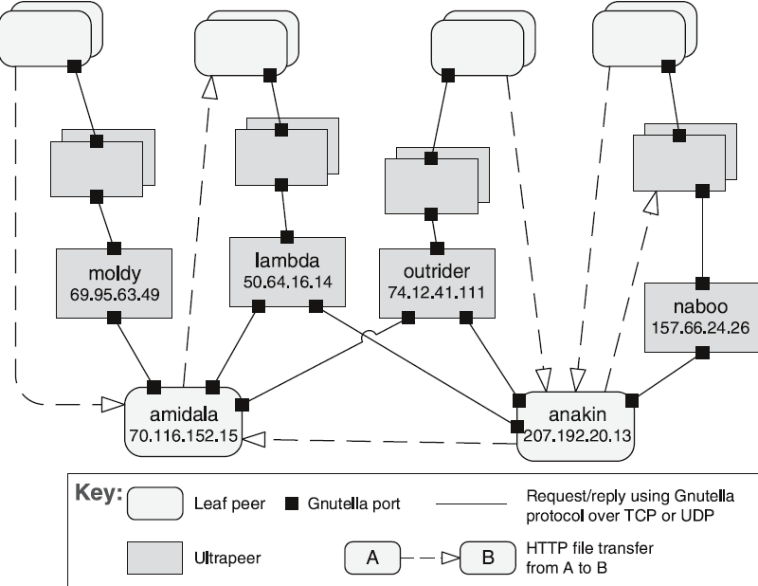
Peer-to-Peer Example
Notes:
BitTorrent the most famous example of P2P. Small number of nodes for bootstrapping. Nodes never know the whole list of nodes, just cryptographically computed neighbors. Given a piece of content you can calculate which nodes will contain all the pieces. Each node has an id that lets you figure out where in the topology it lives, and what it’s neighbors are. So you can efficiently search the space to find the actual nodes that can give you the content you want.

Slide 45
Peer-to-Peer Solution
Overview: Computation is achieved by cooperating peers that request service from and provide services to one another across a network.
Elements:
Peer, which is an independent component running on a network node. Special peer components can provide routing, indexing, and peer search capability.
Request/reply connector, which is used to connect to the peer network, search for other peers, and invoke services from other peers. In some cases, the need for a reply is done away with.
Relations: The relation associates peers with their connectors. Attachments may change at runtime.

Slide 46
Peer-to-Peer Solution - contd
Constraints: Restrictions may be placed on the following:
The number of allowable attachments to any given peer
The number of hops used for searching for a peer
Which peers know about which other peers
Some P2P networks are organized with star topologies, in which peers only connect to supernodes.
Weaknesses:
Managing security, data consistency, data/service availability, backup, and recovery are all more complex.
Small peer-to-peer systems may not be able to consistently achieve quality goals such as performance and availability.

Slide 47
Publish-Subscribe Pattern
Context: There are a number of independent producers and consumers of data that must interact. The precise number and nature of the data producers and consumers are not predetermined or fixed, nor is the data that they share.
Problem: How can we create integration mechanisms that support the ability to transmit messages among the producers and consumers so they are unaware of each other’s identity, or potentially even their existence?
Solution: In the publish-subscribe pattern, components interact via announced messages, or events. Components may subscribe to a set of events. Publisher components place events on the bus by announcing them; the connector then delivers those events to the subscriber components that have registered an interest in those events.
Notes:
Layer Pattern
Broker Pattern
Model View Controller Pattern
Pipe and Filter Pattern
Client Server Pattern
Peer to Peer Pattern
Publish Subscribe Pattern

Slide 48
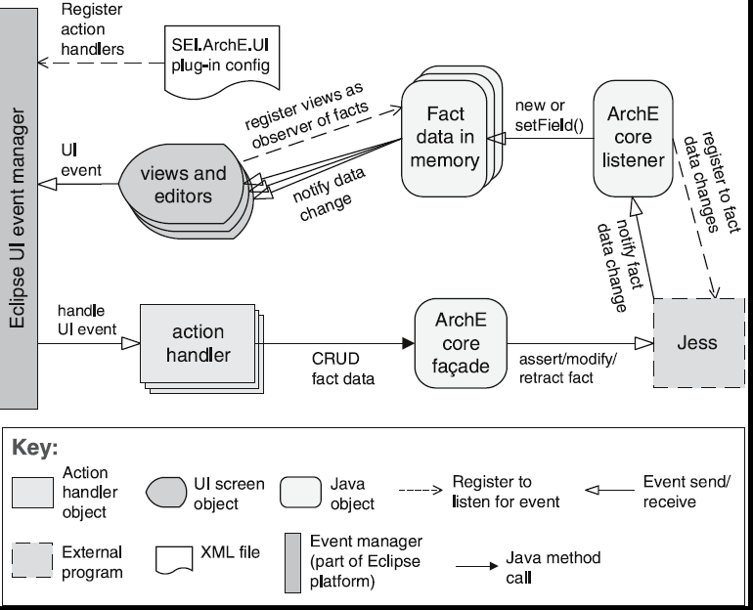
Publish-Subscribe Example

Slide 49
Publish-Subscribe Solution
Overview: Components publish and subscribe to events. When an event is announced by a component, the connector infrastructure dispatches the event to all registered subscribers.
Elements:
Any C&C component with at least one publish or subscribe port.
The publish-subscribe connector, which will have announce and listen roles for components that wish to publish and subscribe to events.
Relations: The attachment relation associates components with the publish-subscribe connector by prescribing which components announce events and which components are registered to receive events.

Slide 50
Publish-Subscribe Solution - contd
Constraints: All components are connected to an event distributor that may be viewed as either a bus—connector—or a component. Publish ports are attached to announce roles and subscribe ports are attached to listen roles.
Weaknesses:
Typically increases latency and has a negative effect on scalability and predictability of message delivery time.
Less control over ordering of messages, and delivery of messages is not guaranteed.

Slide 51

Architectural Tactics
Patterns are composed of fundamental design decisions known as tactics. Tactics, therefore, are the building blocks of design from which architectural patterns are created.

Slide 52
Availability Tactics

Slide 53
Goal of Availability Tactics
A failure occurs when the system no longer delivers a service consistent with its specification
this failure is observable by the system’s actors.
A fault (or combination of faults) has the potential to cause a failure.
Availability tactics enable a system to endure faults so that services remain compliant with their specifications.
The tactics keep faults from becoming failures or at least bound the effects of the fault and make repair possible.

Slide 54
Availability Tactics
Notes:
Talk about watchdogs in software. Take advantage of threading.
Talk about Voting and 2Phase Commits.
2Phase Commit: Coordinator sends Prepare messages. Participants (tables) prepare the change and write in stable storage what they are doing to the table (so they can undo it). When done writing the undo logs, and changing their tables they vote commit. Coordinator once it receives commit messages from all participants it sends global commit message to all of them. Upon receiving global commits they move on and changes are permanents.
If anyone votes abort the coordinator tells them all to abort and undo their changes. Failure cases: Participant fails before voting. When they come back up they notice they never voted commit (transaction is outstanding) and immediately vote abort. Participant fails after voting commit. When the come back they contact coordinator and ask what was the outcome. Coordinator (if they are up) tells them and they proceed appropriately. Coordinator fails before sending global commit. Everyone needs to wait. When coordinator is back up will check its state and sends the global commit.
Coordinator fails before receiving all states. Everyone needs to wait. When coordinator is back up it notices incomplete voting record and aborts.
What about lost messages? Timeouts are used and result in ABORTS.

Slide 55
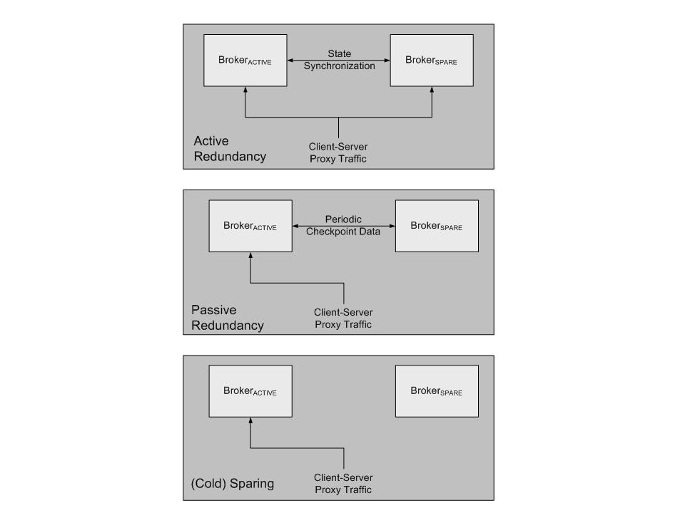
Redundancy
Key:
process:
message:
Notes:
Active, Passive, Spare.
Active = Load balanced between multiple replicas with active state synchronization. How to loadbalance? Packet level, Session level, Request level load balancing.
Passive = Only one does work, periodic synchronization, ok to lose some data
Spare = Only one does work, no sync, must be stateless

Slide 56

Security Tactics

Slide 57
Security Tactics

Slide 58
Modifiability Tactics

Slide 59
Modifiability Tactics
Notes:
Example: Code reads from DB, initially a postgress DB. What if you want to change the DB, the schema, add caching for performance etc?
Solution: Create a Data Access Layer (Indirection). The main system does not need to know anything about DB any more. All changes localized to the DAL.

Slide 60

Performance Tactics

Slide 61
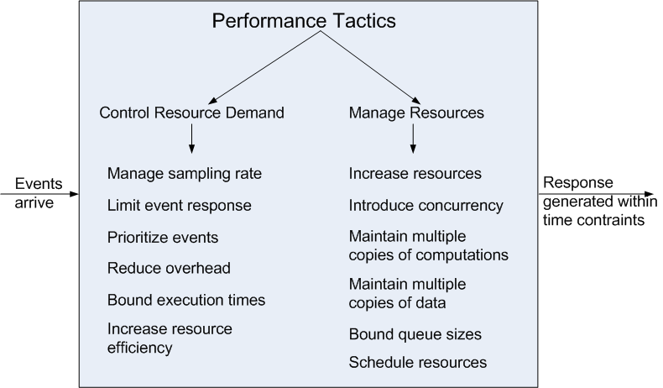
Performance Tactics

Slide 62
Relationships Between Tactics and Patterns
Patterns are built from tactics; if a pattern is a molecule, a tactic is an atom.
MVC, for example utilizes the tactics:
Increase semantic coherence
Encapsulation
Use an intermediary
Use run time binding
Notes:
Semantic Coherence -> Model only has business logic and data. View only has display logic. Controller-> only handles input and control flow Encapsulation -> Model encaps data, View encaps rendering and presentation
Intermediary -> Controls data updates and presentation selection
Runtime bindings -> Less obvious but in theory you would decide which model, view and controller to hook together at runtime (think adopting to mobile vs desktop screens, or high powered vs low powered devices, or handicapp support Uis etc.)

Slide 63
Tactics Augment Patterns
Patterns solve a specific problem but are neutral or have weaknesses with respect to other qualities.
Consider the broker pattern
May have performance bottlenecks
May have a single point of failure
Using tactics such as
Increase resources will help performance
Maintain multiple copies will help availability

Slide 64
Tactics and Interactions
Each tactic has pluses (its reason for being) and minuses – side effects.
Use additional tactics can help alleviate the minuses.
But nothing is free…

Slide 65
Tactics and Interactions - 2
A common tactic for detecting faults is Ping/Echo.
Common side-effects of Ping/Echo are:
security: how to prevent a ping flood attack?
performance: how to ensure that the performance overhead of ping/echo is small?
modifiability: how to add ping/echo to the existing architecture?
Notes:
Tactic is fine grain adjustment of quality attributes within a pattern

Slide 66
Tactics and Interactions - 3
System
Ping/Echo
Add to
system
Ping
flood
Performance
overhead
Notes:
Tactic is fine grain adjustment of quality attributes within a pattern

Slide 67
Tactics and Interactions - 4
A tactic to address the performance side-effect is “Increase Available Resources”.
Common side effects of Increase Available Resources are:
cost: increased resources cost more
performance: how to utilize the increase resources efficiently?
Notes:
Tactic is fine grain adjustment of quality attributes within a pattern

Slide 68
Tactics and Interactions - 5
System
Ping/Echo
Add to
system
Ping
flood
Performance
overhead
Increase Available
Resources
Cost
Resource
Utilization
Notes:
Tactic is fine grain adjustment of quality attributes within a pattern

Slide 69
Tactics and Interactions - 6
A tactic to address the efficient use of resources side-effect is “Scheduling Policy”.
Common side effects of Scheduling Policy are:
modifiability: how to add the scheduling policy to the existing architecture
modifiability: how to change the scheduling policy in the future?
Notes:
Tactic is fine grain adjustment of quality attributes within a pattern

Slide 70
Tactics and Interactions - 7
System
Ping/Echo
Add to
system
Ping
flood
Performance
overhead
Increase Available
Resources
Cost
Resource
Utilization
Scheduling
Policy
Add to
system
Modify
policy
Notes:
Tactic is fine grain adjustment of quality attributes within a pattern

Slide 71
Tactics and Interactions - 8
A tactic to address the addition of the scheduler to the system is “Use an Intermediary”.
Common side effects of Use an Intermediary are:
modifiability: how to ensure that all communication passes through the intermediary?
Notes:
Tactic is fine grain adjustment of quality attributes within a pattern

Slide 72
Tactics and Interactions - 9
System
Ping/Echo
Add to
system
Ping
flood
Performance
overhead
Increase Available
Resources
Cost
Resource
Utilization
Scheduling
Policy
Add to
system
Modify
policy
Use an
Intermediary
Ensure
usage
Notes:
Tactic is fine grain adjustment of quality attributes within a pattern

Slide 73
Tactics and Interactions – 10.
A tactic to address the concern that all communication passes through the intermediary is “Restrict Communication Paths”.
Common side effects of Restrict Communication Paths are:
performance: how to ensure that the performance overhead of the intermediary are not excessive?
Note: this design problem has now become recursive!
Notes:
Tactic is fine grain adjustment of quality attributes within a pattern

Slide 74
How Does This Process End?
Each use of tactic introduces new concerns.
Each new concern causes new tactics to be added.
Are we in an infinite progression?
No. Eventually the side-effects of each tactic become small enough to ignore.

Slide 75
Summary
An architectural pattern
is a package of design decisions that is found repeatedly in practice,
has known properties that permit reuse, and
describes a class of architectures.
Tactics are simpler than patterns
Patterns are underspecified with respect to real systems so they have to be augmented with tactics.
Augmentation ends when requirements for a specific system are satisfied.

